Slide 1
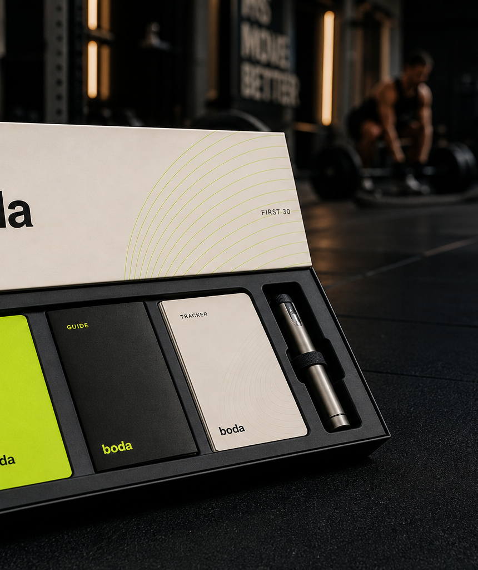
boda
PARTNER PROGRAM
Refer suitable clients. Earn 12.5%.
A premium referral path for Dubai's active wellness market, built around assessment, product clarity, welcome packs, and responsible handoff.
12.5%
partner commission on referred sales
Boda Health Partner Program
01

Slide 2
boda
THE OPPORTUNITY
Active clients already ask better wellness questions.
What clients are already asking about
Energy
Recovery
The demand is real, but the first step is often messy. Partners can point clients toward a structured route without becoming the product or medical authority.
Sleep
Body comp
The gap
Boda turns curiosity into a cleaner first conversation.
Random supplier searches create uncertainty around product detail, documentation, and the first buying experience.
Boda Health Partner Program
02

Slide 3
boda
WHAT BODA IS
Not a peptide shop. A clearer way to start.
The partner does not need to stock product, explain protocols, or run fulfillment. Boda owns the customer journey and routes regulated responsibilities to the right pathway.
01
Partner attention
02
Boda front end
03
Authorized handoff
Trusted partners introduce suitable people who are already asking about performance, recovery, body confidence, focus, or long-term wellbeing.
Boda handles discovery, education, lifestyle assessment, cart flow, documentation routes, welcome-pack experience, and support triage.
Product approval, regulated supply, release, and fulfillment sit with licensed or authorized partners where applicable.
Boda Health Partner Program
03

Slide 4
boda
THE PARTNER OFFER
Refer suitable clients. Earn 12.5%.
12.5%
of referred sales
Final commercial terms should define refunds, cancellations, taxes, shipping, and payment timing.
Share a unique link, QR code, or warm intro.
Boda follows up, assesses interest, and manages the next step.
Commission reporting is tied back to the partner route.
Boda Health Partner Program
04

Slide 5
boda
CUSTOMER EXPERIENCE
A premium first step, not a cold product list.
Free 15-minute assessment
Simple product lanes
Lifestyle, training, sleep, recovery, and wellbeing context before product decisions.
Metabolic, recovery, performance, longevity, focus, skin and hair, and sleep.
Welcome-pack experience
Documentation route
A more confident first order with cards, documents, and support direction.
Product specs, COA routes where supplied, FAQ, and responsible-use language.
Boda Health Partner Program
05

Slide 6
boda
WHY IT CONVERTS
Clear enough to start. Structured enough to trust.
Proof points partners can send
Product pages
Partners can send a real experience, not a vague promise. The public journey already has the trust assets a warm referral needs.
Product guides
FAQ and COA route
Welcome-pack assets
Built assets are already live
FAQ, legal, responsible-use, shipping, returns, COA, welcome pack, and product guide links support the follow-up.
Boda Health Partner Program
06

Slide 7
boda
PARTNER BOUNDARIES
Partners introduce. Boda handles the follow-up.
The partner role is simple: make the warm introduction and use approved wording.
No dosage advice, protocols, treatment advice, or medical claims.
Detailed product, medical, or fulfillment questions route back to Boda.
No product approval, regulated supply, release, or fulfillment handling.
No outcome promises around weight loss, anti-aging, recovery, cognition, or safety.
Boda Health Partner Program
07

Slide 8
boda
PARTNER MATERIALS
Everything needed to start sending.
Send
Track
Stay clean
Matthew can send the one-page overview, pitch deck, approved intro messages, and partner-specific link.
QR and referral links keep partner routes clean, so commission reporting does not get lost.
Product, FAQ, COA, welcome-pack, and boundaries links keep partners away from medical claims.
ONE-PAGER
DECK
MESSAGES
QR/LINK
PRODUCT LINKS
BOUNDARIES
Boda Health Partner Program
08

Slide 9
boda
IDEAL PARTNERS
Best fit: trusted people with active audiences.
Personal trainers
Gyms and studios
Clients already ask about body composition, performance, and recovery.
Audience is concentrated, active, and open to premium wellness introductions.
Recovery operators
Warm referrers
Boda fits around routines where sleep, recovery, and consistency already matter.
High-trust connectors can introduce suitable people without managing the journey.
The common denominator is trust: partners should already have active audiences who value structured routines.
Boda Health Partner Program
09

Slide 10
boda
NEXT STEP
Send the link. Boda does the rest.
Matthew sets up the partner route.
Partner shares the approved link or intro message.
Boda captures interest, assesses fit, and manages the journey.
BODA.HEALTH/PARTNERS
Boda Health Partner Program
10

